Slide 1

Meet ‘n’ greet
An improvement for the public lifestyle
Lucas Salazar

Slide 2
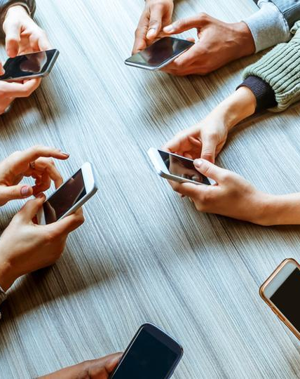
Problem
What is currently happening?
Communication is becoming digitally oriented
Social networks are disappearing
Shared spaces are being forgotten and abandoned
This is Change!

Slide 3

DIGITAL TECH IS BRINGING THE CHANGE TOWARDS ALL OUR COMMUNITIES. BUT THAT DOESN’T MEAN WE CANNOT USE IT TO CHANGE OURSELVES.

Slide 4
Meet ‘n’ Greet
Let’s Dive In

Slide 5
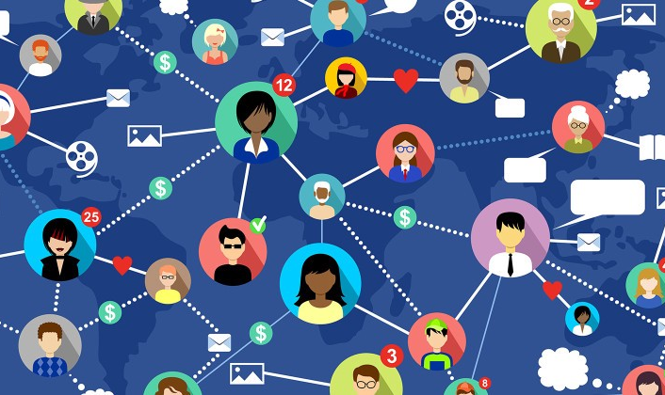
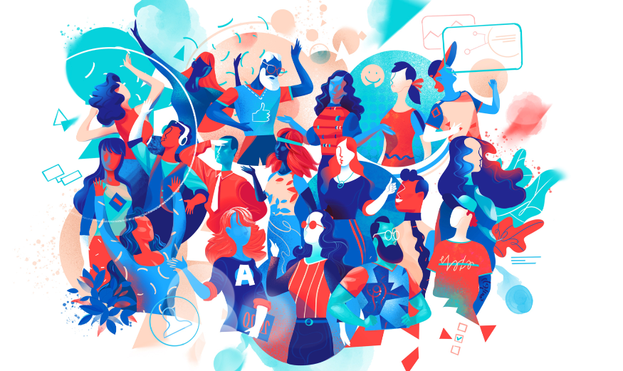

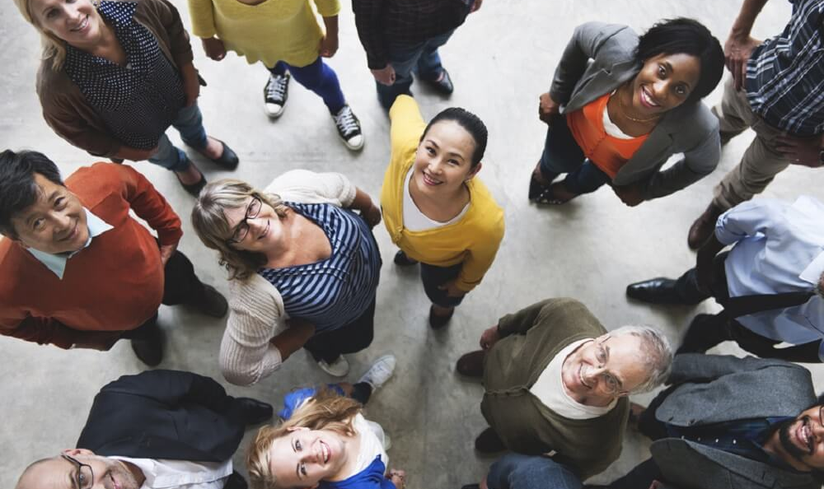
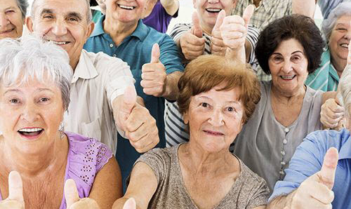
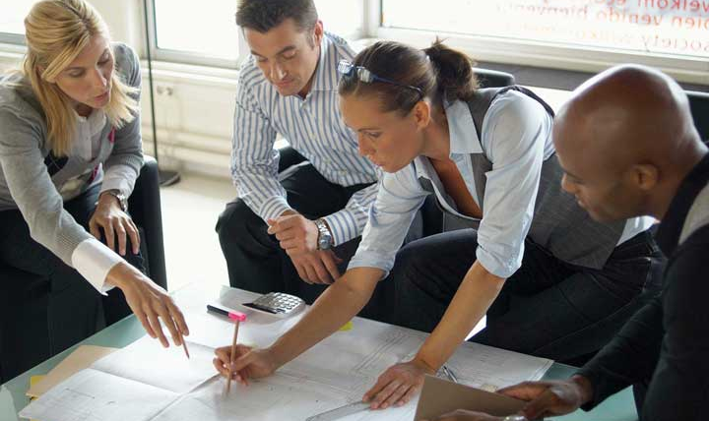
Meet the opportunities
Public dancing groups
Board games clubs
Reading meetings
Coffee tasting tours
Videogames clubs
Many others…

